Slide 1
Photomicrographs of Plant foods
Fennel
Permission to reproduce original photomicrographs used to make this collection may be obtained from
Dr. David O. Norris at
david.norris@colorado.edu

Slide 2
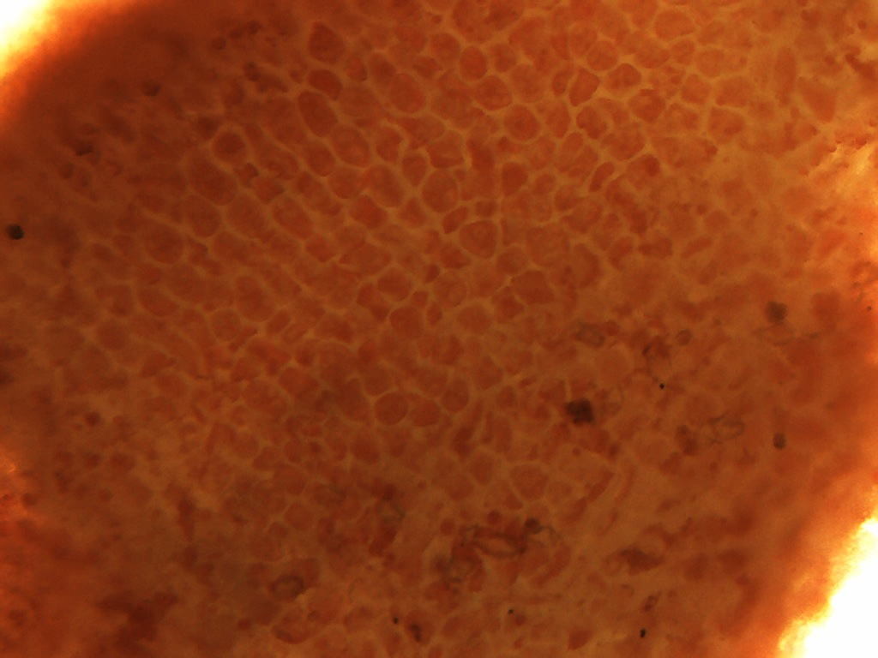
Notes:
189. Foeniculum vulgare L. Fennel. Seed coat (testa) epidermis, 10X.

Slide 3
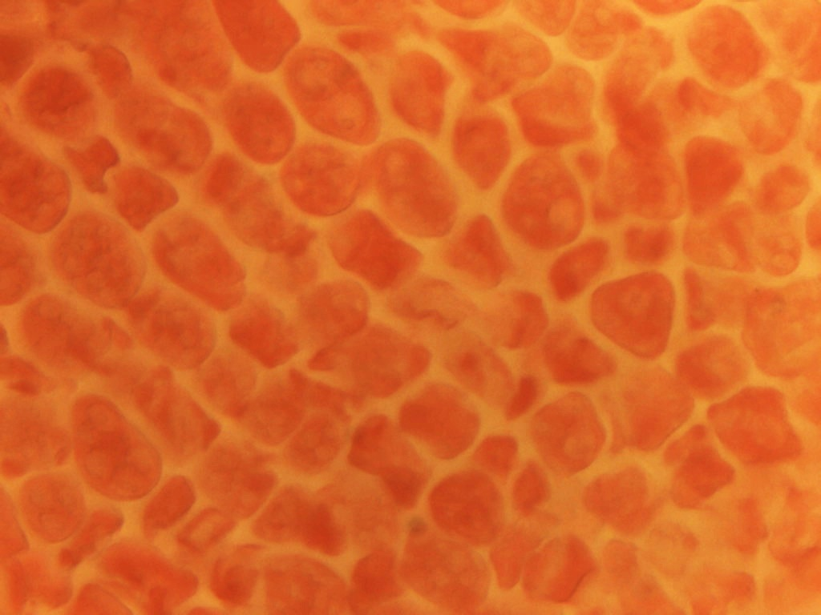
Notes:
190. Fennel. Seed coat (testa) epidermis, 25X.

Slide 4
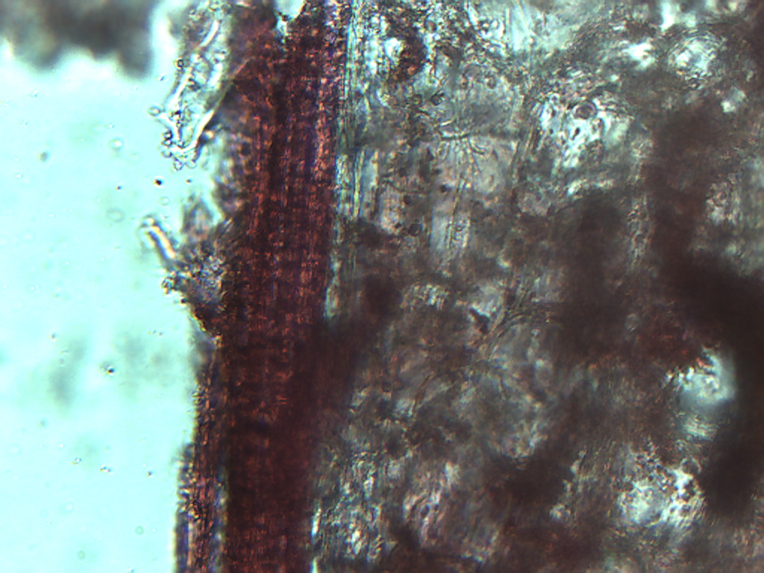
Notes:
191. Fennel. Vascular tissue, 25X.

Slide 5
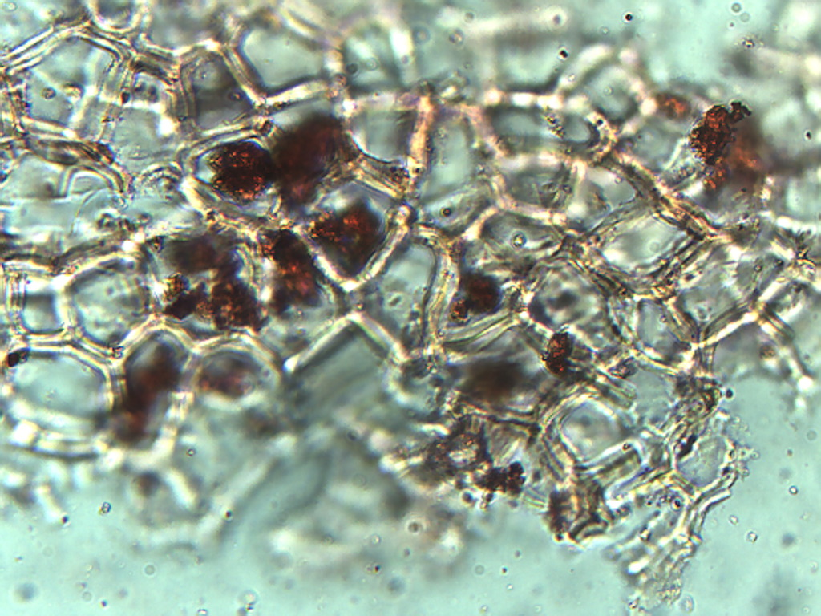
Notes:
192. Fennel. Epidermis, 25X.

